Slide 1
Heap & Inserting into a Heap

Slide 2
Introduction to Heap
What is a Heap Data structure?
Suppose H is a complete binary tree. Then H is called a heap, or a max heap, if each node N of H has the following property: The value of N is greater than or equal to the value at each of the children of N.
97
88
95
66
55
95
48

Slide 3
Types of Heap
Max Heap
Min Heap
P > = Q and P > = R
Q > = R or Q < = R
P < = Q and P < = R
Q > = R or Q < = R
P
Q
R

Slide 4
Representation Of Max Heap
97
88
95
1 | 2 | 3 | 4 | 5 | 6 | 7
97 | 88 | 95 | 66 | 55 | 95 | 48
66
55
95
48
(a) Heap Tree
(b) Sequential representation

Slide 5
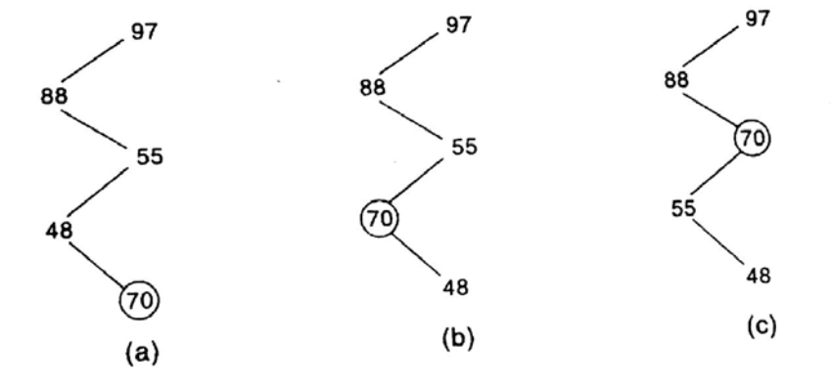
Inserting into a Heap
Adjoin item at the end of H so that H is still a complete tree, but not necessarily a heap.
Then let ITEM rise to its “appropriate place” in H so that H is finally a heap

Slide 6
INSHEAP(TREE, N, ITEM)

Slide 7
Inserting 44
44 | 30 | 50 | 22 | 60 | 55 | 77 | 55
44

Slide 8
Inserting 30
44 | 30 | 50 | 22 | 60 | 55 | 77 | 55
44
30

Slide 9
Inserting 50
44 | 30 | 50 | 22 | 60 | 55 | 77 | 55
44
50
30
50
30
44
(a)
(b)

Slide 10
Inserting 22
44 | 30 | 50 | 22 | 60 | 55 | 77 | 55
50
30
44
22

Slide 11
Inserting 60
44 | 30 | 50 | 22 | 60 | 55 | 77 | 55
50
50
60
30
44
60
44
50
44
22
60
22
30
22
30
(a)
(b)
(c)

Slide 12
Inserting 55
44 | 30 | 50 | 22 | 60 | 55 | 77 | 55
60
60
50
44
50
55
22
30
55
22
30
44
(a)
(b)

Slide 13
Inserting 77 (Home Task)
44 | 30 | 50 | 22 | 60 | 55 | 77 | 55

Slide 14
Inserting 55 (Home Task)
44 | 30 | 50 | 22 | 60 | 55 | 77 | 55

Slide 15
INSHEAP(TREE, N, ITEM)

Slide 16
Practice problem
Build a maxheap and a min heap using following data:
16, 18, 22, 20, 15, 4o

